Slide 1


LINANKIS.DIGITAL
CHALLENGE
Presented by: Tasoulis k SIA

Slide 2


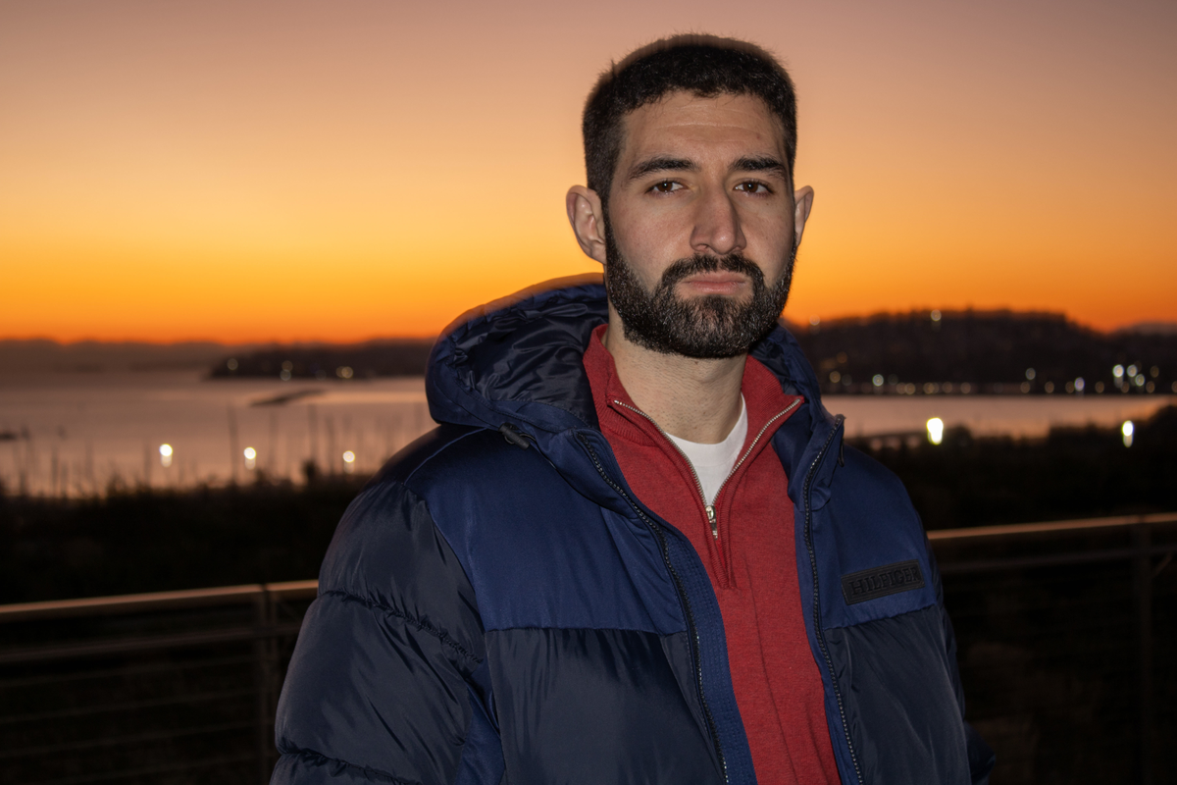

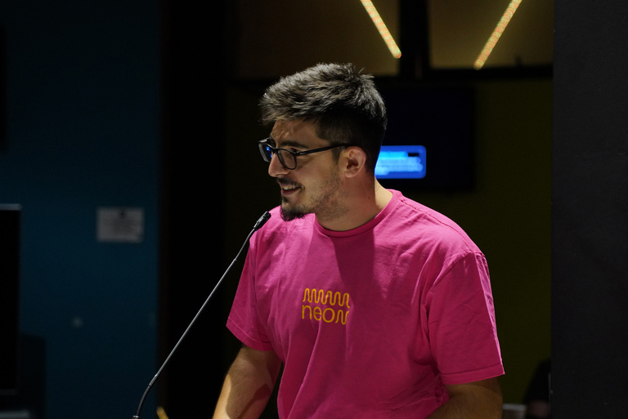
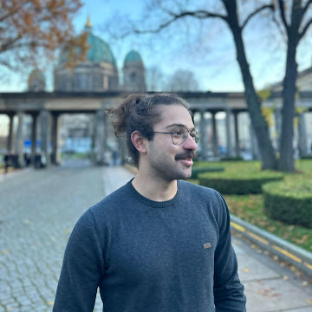


OUR TEAM
Tilemachos Aravanis
Anthi Vozinaki
Dimitris Damianos
Anastasis Kapetanakis
Giannis Chatzis

Slide 3
PROBLEM
Compare and review figma designs and their web implementation, in a frictionless manner which provides information regarding mistakes, mismatches and inconsistencies.

Slide 4
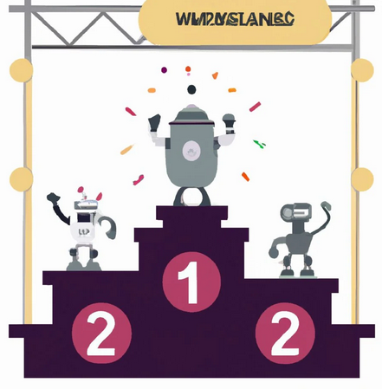
MOTIVATION
AI/ML models scale in a rapid way (scalability).
Classic comparison algorithms are specific and do not scale.

Slide 5






SOLUTION
Global Similarity Score
Extract a global similarity score of the Figma design and the web page image
NLP Analysis
Deploy a LLM to get a global sense of the differences between the two images..
ObjectDetection Pipeline
Using object detection and comparing the respective object patches, we find image mismatches.
OCR Pipeline
Using Azure’s OCR APIs, we extract text from the design and the web implemention and use it to find errors and inco

Slide 6
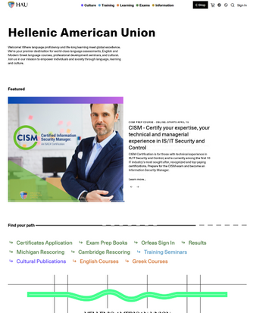
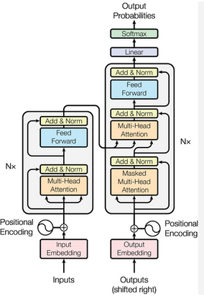
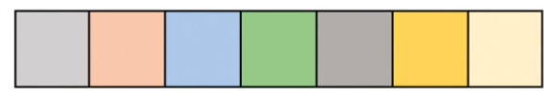


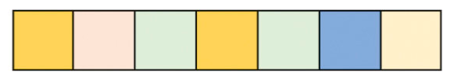
GLOBAL SIMILARITY SCORE
Web design
Cosine Similarity
Images match
43%
Figma design

Slide 7

NLP ANALYSIS
“The two images represent the same website, but the first image appears to be a mockup or design prototype, while the second image shows the actual implementation or live version of the website. Differences between the mockup (first image) and the implemented website (second image). Layout: The implemented website has a different layout...”
Web design
“Find the differences between the two Images.”
Figma design

Slide 8

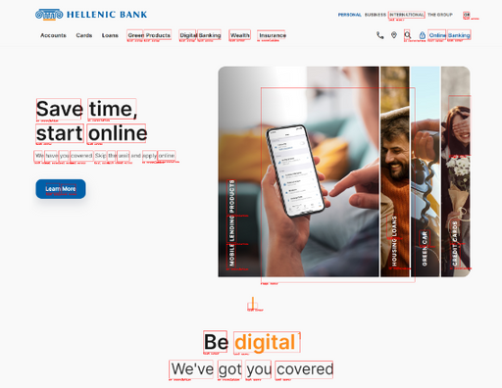

OBJECT DETECTION PIPELINE
Detect Objects in image (e.g. person)
and crop
Embed the Object patches
Web design
Comparison
Detect Objects in image (e.g. person)
and crop
Embedd the Object patches
Figma design

Slide 9
OCR PIPELINE
Detected text
and position
Detected
errors
Web page
Comparison
Algorithm
Detected text
and position
Figma design

Slide 10
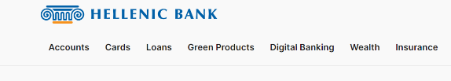




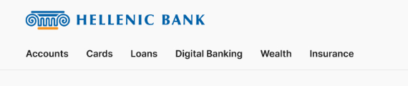
COMPARISON
ALGORITHM
Compare word found in designer with each neighbor in developer’s web page
Screenshot from designer’s abstract implementation
Screenshot from developer’s implementation

Slide 11

COMPARISON
ALGORITHM
Compare word found in designer with each neighbor in developer’s web page
Screenshot from designer’s abstract implementation
Nearest relative neighbor is “Digital Banking”
Screenshot from developer’s implementation

Slide 12

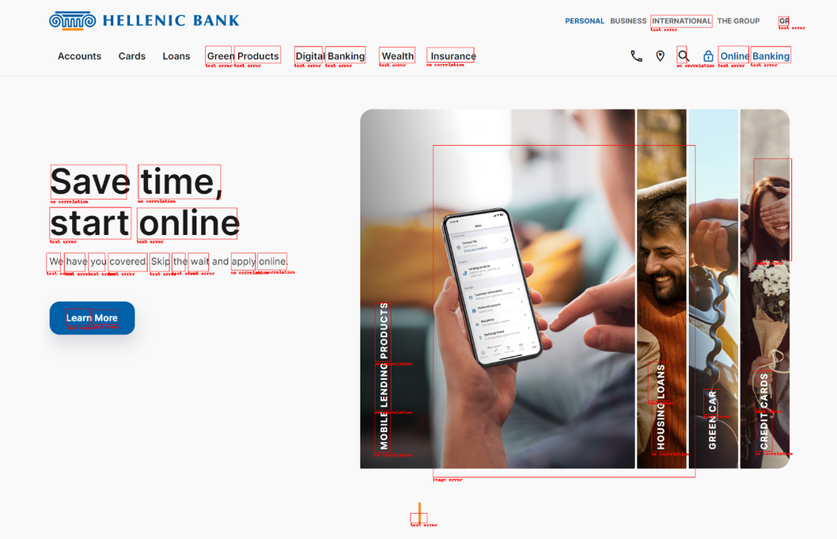
RESULTS
VS
figma design
web page with errors indicated

Slide 13
FUTURE IMPLEMENTATION
AND INTEGRATION

Slide 14

FONT DETECTION
Calibri,
Calibri light....
Extract
top 5 fonts
using WhatFontIs API
Web page
Crop
sentence
Compare
Ariel,
Times New Roman...
Figma design

Slide 15
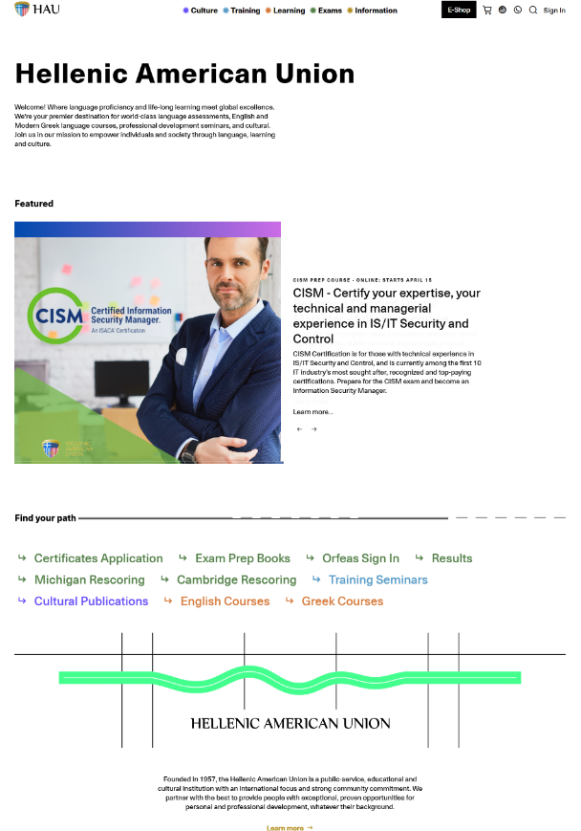




FOCUS ON RELEVANT FEATURES
Correlate common sections and compare only those with iterative alogrithms
Web page
Figma design

Slide 16
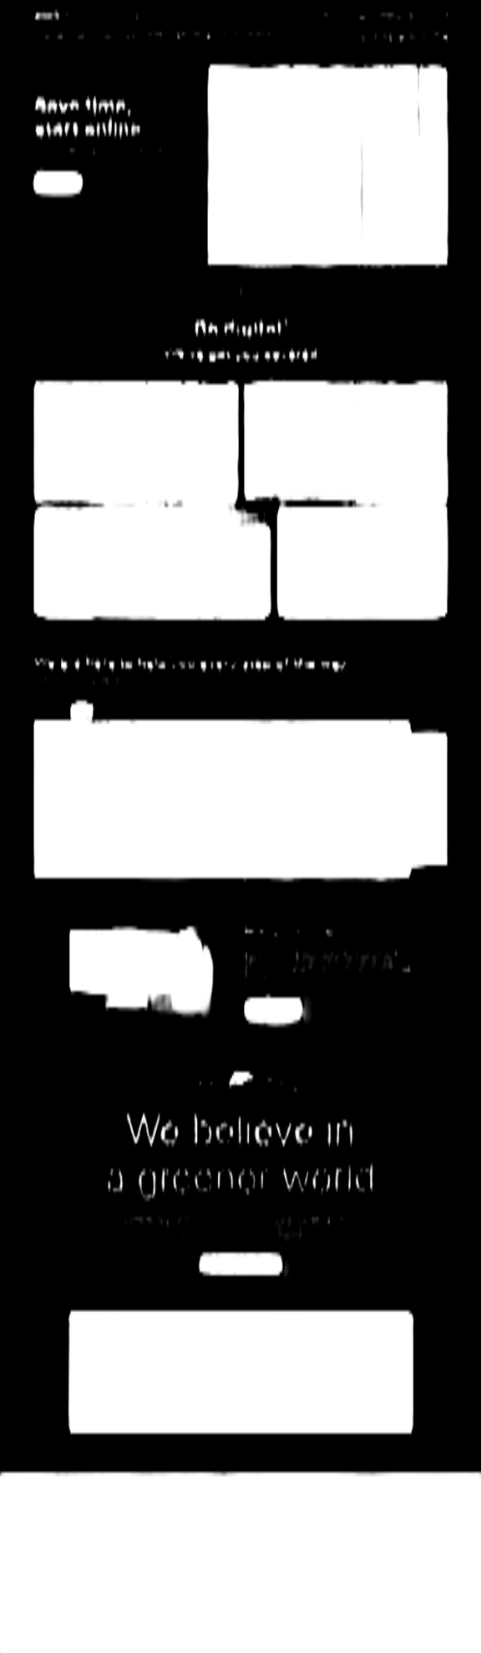
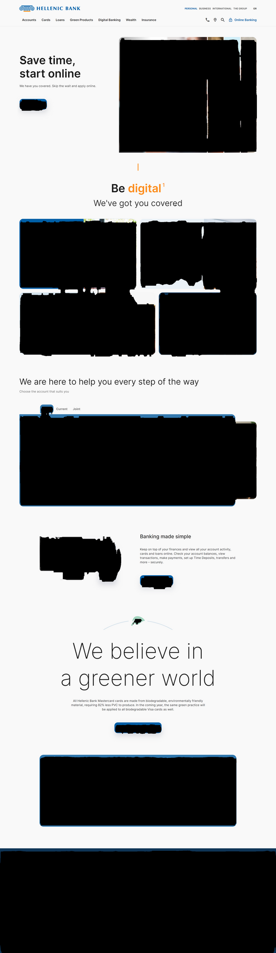
BACKGROUND COLOR AND
STYLE DETECTION

Slide 17
EXTRA MILE
Make the hyperparameters of our algorithms trainable and define a loss function according to User Human Feedback.

Slide 18

Thank you
Any Questions?

